Slide 1
The Exam System – User Guide Global Technology Legal Compliance
June 01, 2012
Confidential

Slide 2
Agenda
Getting started:
Registering
Admin Page
Exam Creation
User Editing
User Page
Exam taking

Slide 3
Getting Started
The Basics

Slide 4
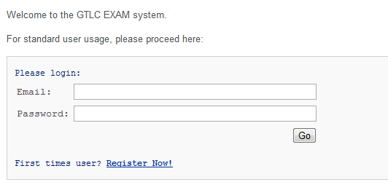
Registering
Click on the hyperlink to bring you to the registration page
- After supplying the required information, your will be created!

Slide 5
Admin Rights/Page
There are a few

Slide 6
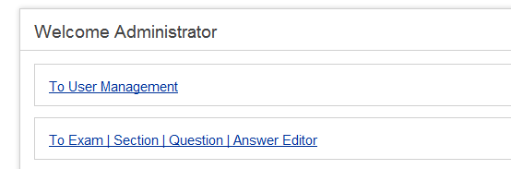
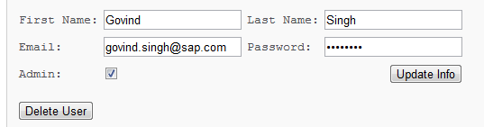

Admin Power
Only existing administrators can give new users admin rights as well;
This is done through User Management:
Select a user, check ‘Admin’ and click Update Info
It is also from this panel that the administrator can see all previous exam attempts done by the user:

Slide 7
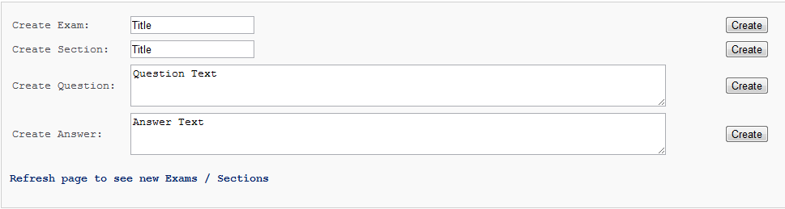
Exam Creation Page
You are able to create Exams, Sections, Questions and Answers here; as well as associate them to one another as you see fit.
Note: Although the ‘create’ buttons are designed to refresh the exam/section/question/answer lists, the AJAX call has been shown to be error prone on Mozilla Browsers as well as IE.

Slide 8
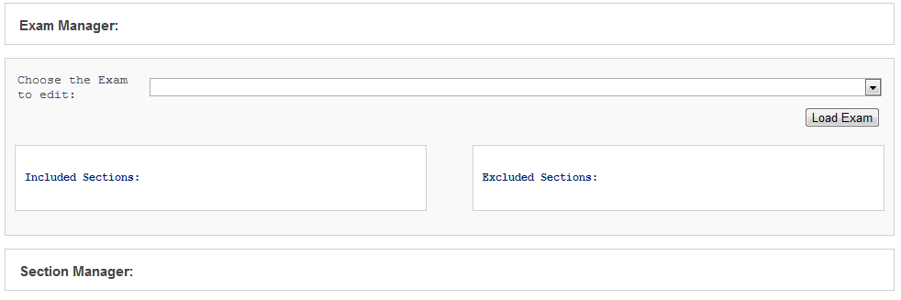
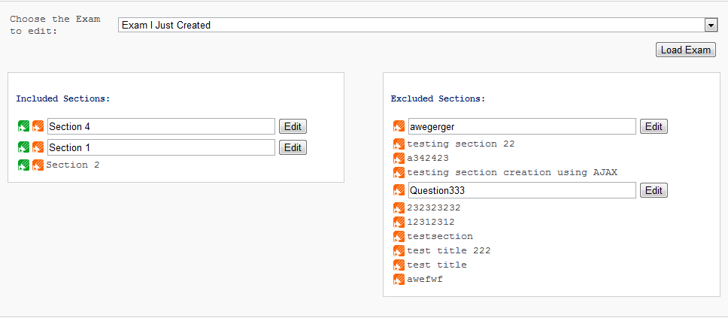
The Managers
Once your exams, sections, etc.. Have been created, you can associate them together using the provided managers.
Select an exam to edit
The exam will automatically load
It will display all in/excluded sections
The green edit button allows you to load an iframe containing the manager of that particular section
The orange button will allow you to edit the section title

Slide 9
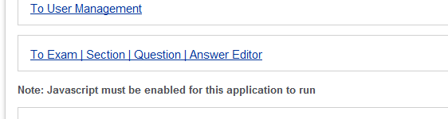
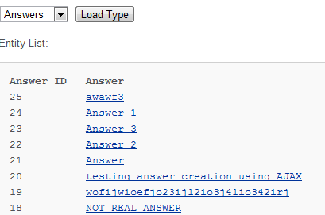
Big Edits
If you require to do an a larger edit to a particular question/answer, you can the actual editor panel to so.
Select the type of entity you wish to edit
Select the actual entity
Edit away
Note: this offers the same functionality as using the orange edit button; this simply give you a larger text area to type in.

Slide 10
User Page

Slide 11
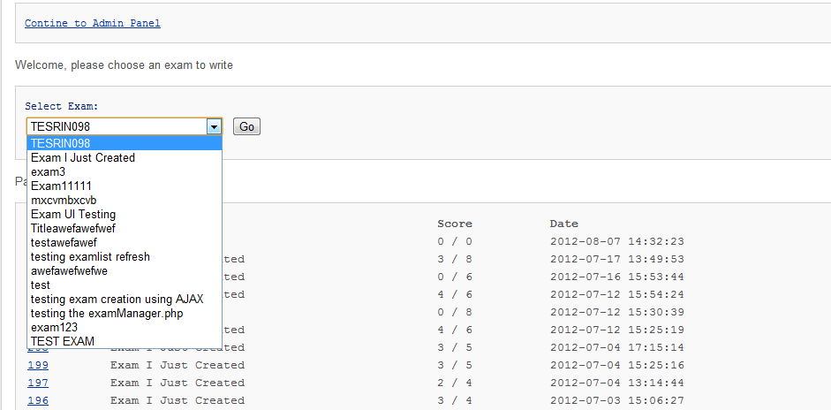
The User Panel
The user panel contains all things which non admins will ever require.
Exam selector for taking exams
Record of previously taken exams with scores and dates taken
Links to past exams to see correct answers and what they answered with

Slide 12
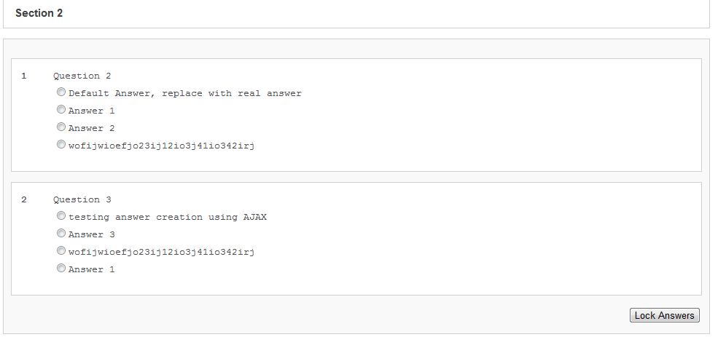
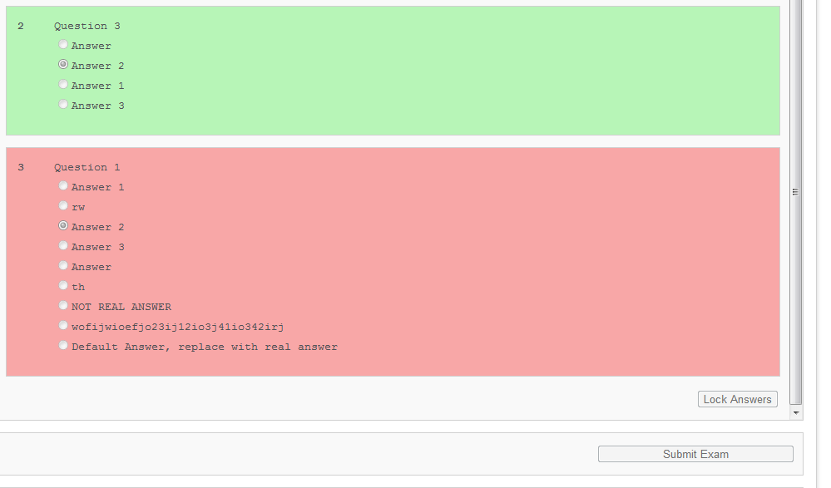

Exam Taking
After Selecting an Exam and pressing Go, the user will be greeted with a list of sections containing the questions and possible answers
All non answered questions are assumed wrong
Users must click ‘Lock Answers’ at the end of every section
At the end, users will click “Submit Exam”
The exam will then be saved to the server and the correct answers will be highlighted in green and incorrect in red

Slide 13
Thank You!
For more complete examples of what a context file should look like, as well as the actual XML Scema, please refer to this site:
https://tdwiki.pgdev.sap.corp/display/GTLC/Context+File+Requirement

